Slide 1
Working in Oracle9i Reports Developer
Notes:
Schedule: Timing Topic
<xx> minutes Lecture
<xx> minutes Practice
<xx> minutes Total

Slide 2
Objectives
After completing this lesson, you should be able to do the following:
  Describe the main Oracle9i Reports executables
  Describe the main components of Reports Builder
  Describe the main objects in a report

Slide 3
Executables
Developer
Reports Services
Reports Builder
rwbuilder
Reports Runtime
rwrun
Reports Converter
rwconverter
Reports Server
rwserver
Reports Client
rwclient
Queue Manager
rwrqm
Reports Servlet
rwservlet
Reports CGI
rwcgi

Slide 4
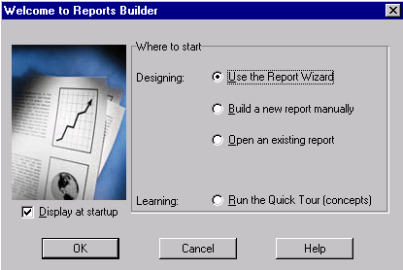
Invoking Reports Builder

Slide 5


Modules
Report
Template
PL/SQL Library

Slide 6
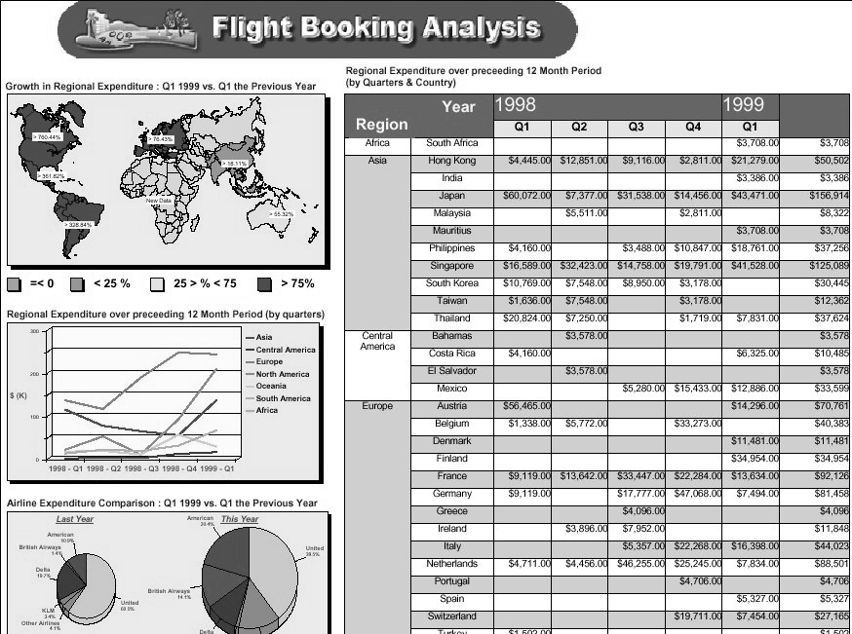
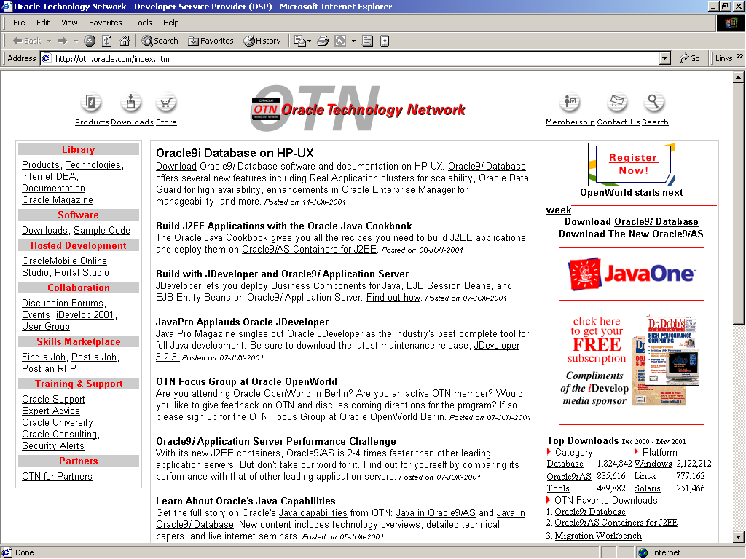
Data and Layout
Paper
Web

Slide 7

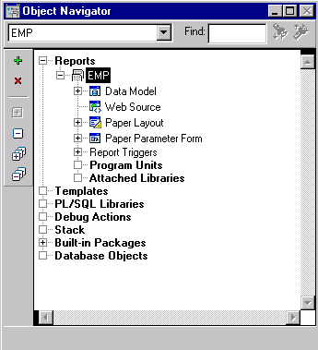
Reports Builder Components

Slide 8
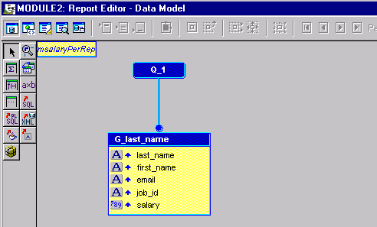
Reports Builder Components

Slide 9
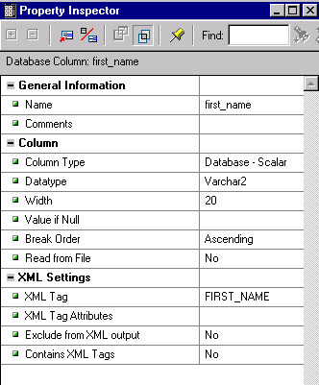
Reports Builder Components

Slide 10
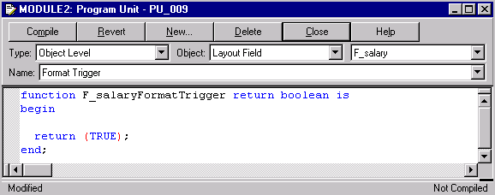
Reports Builder Components

Slide 11

Main Menu Structure

Slide 12
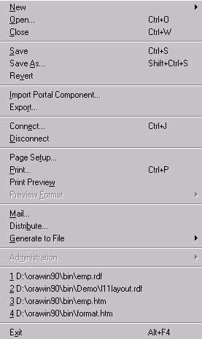
Main Menu Structure

Slide 13

Main Menu Structure

Slide 14
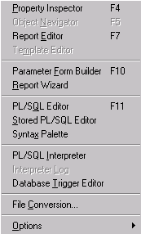
Main Menu Structure

Slide 15
Wizards
  Report Wizard
  Data Wizard
  Graph Wizard
  Report Block Wizard

Slide 16
Report Editor
  Data Model
  Web Source
  Paper Layout
  Paper Design
  Paper Parameter Form

Slide 17
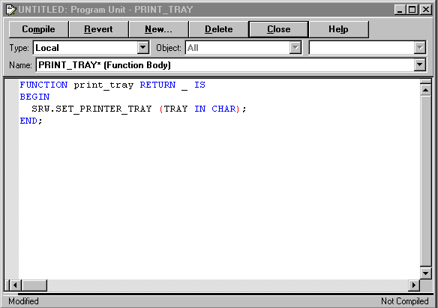
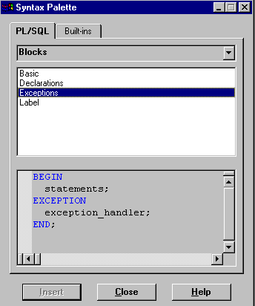
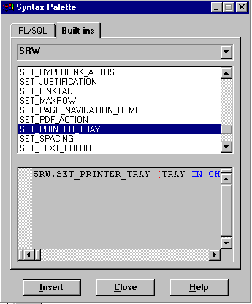
PL/SQL Development Environment:
Syntax Palette

Slide 18
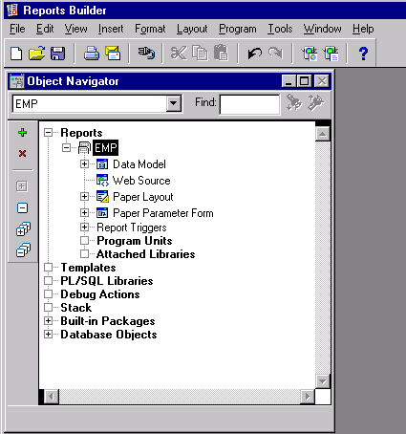
Object Navigator

Slide 19
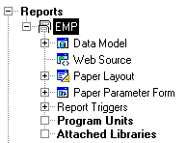
Report-Level Objects
  Properties
  Triggers
  PL/SQL Program Units
  Attached Libraries

Slide 20
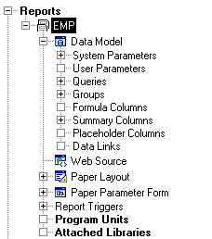
Data Model Objects
  Parameters
  Queries
  Groups
  Columns
  Data Links

Slide 21
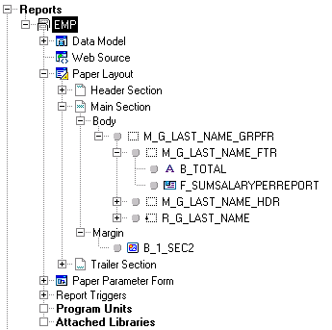
Paper Layout Objects
  Frames
  Repeating frames
  Fields
  Boilerplate

Slide 22
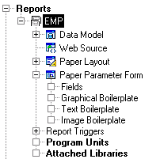
Paper Parameter Form Objects
  Fields
  Boilerplate

Slide 23
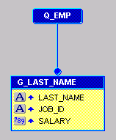
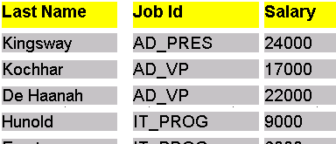
Object Interrelationship
1
Select
...
2
3

Slide 24
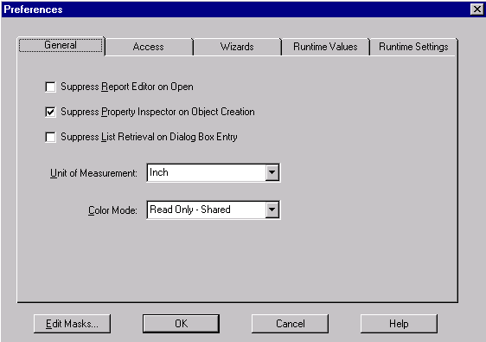
Customizing Your Oracle9i Reports Developer Session

Slide 25

Saving Tools Preferences
1
2
3

Slide 26
Oracle9i Reports Environment Variables
  REPORTS_PATH
  REPORTS_TMP
  REPORTS_RESOURCE
  ORACLE_PATH
Windows: Modify in Registry

Slide 27

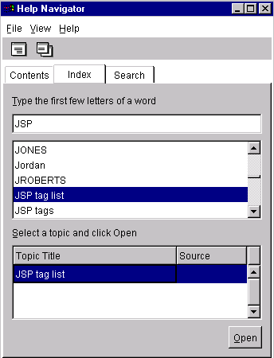
Using the Online Help System

Slide 28
Summary
  In this lesson, you should have learned how to:
  Describe the Oracle9i Reports executables
  List the types of modules you can create in Reports Builder
  Describe the views of the Report Editor
  Describe the main object categories in a report module

Slide 29
Practice 3 Overview
  Invoking Reports Builder
  Opening an existing report
  Switching views in the Report Editor
  Accessing the Help system

